Slide 1


The Simpsons Characters Classification Ensemble
An Ensemble Approach to Image Classification
梁溢彥
312707026

Slide 2

Introduction
In this project, we explore the problem of character classification in "The Simpsons" and propose an ensemble approach to achieve accurate results. By accurately identifying characters, we can gain valuable insights into the show's dynamics and storyline.

Slide 3
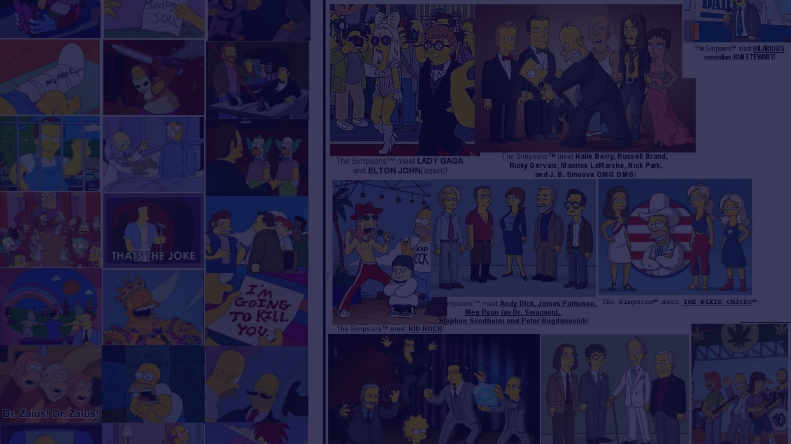
Dataset Overview
Our dataset, obtained from Kaggle, consists of a diverse collection of images featuring characters from "The Simpsons". With a significant number of classes and samples, our dataset provides a robust foundation for training and evaluation.

Slide 4
Methodology - Models Used
To leverage the strengths of different models, we employ an ensemble method. Our ensemble consists of the following models:
EfficientNet B4
Vision Transformer (ViT)
A powerful deep learning model known for its superior performance in image classification tasks.
An innovative transformer-based model that excels at capturing global image features.
Focal Net
ConvNeXt V2
A specialized model designed to enhance the recognition of object features.
A state-of-the-art convolutional neural network model optimized for accuracy and efficiency.

Slide 5

Data Preprocessing
To improve model performance and generalization, we apply various data augmentation techniques, such as random crops, flips, and rotations. Additionally, we perform resizing and normalization to ensure consistency and optimal input for our models.

Slide 6

Ensemble Strategy
Our ensemble method combines the individual model probabilities to make the final prediction. Using a weighted voting mechanism based on model performance, we achieve optimal accuracy and robustness in character classification.

Slide 7
Training
During training, each model undergoes an extensive process of optimization, adjusting hyperparameters, and fine-tuning. The training duration depends on the complexity of the model architecture, but we ensure thorough training for reliable results.
1
EfficientNet B4 Training
Hyperparameters optimized for EfficientNet B4 along with a training duration of 3.2 hours.
2
Vision Transformer (ViT) Training
ViT model training involved fine-tuning and adjusting hyperparameters. The training process lasted 4.5 hours.
3
Focal Net Training
Focal Net was trained using an optimized set of hyperparameters. It achieved convergence within 3.3 hours.
4
ConvNeXt V2 Training
The training process of ConvNeXt V2 involved fine-tuning the model with a duration of 4 hours.

Slide 8
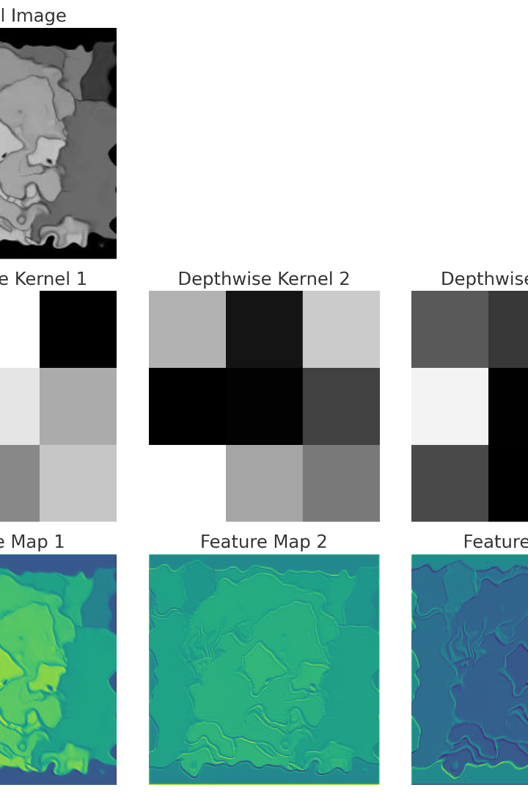
Inference and Evaluation
For inference, we can take a look of the efficient net's kernal,let's see what does it capture.

Slide 9
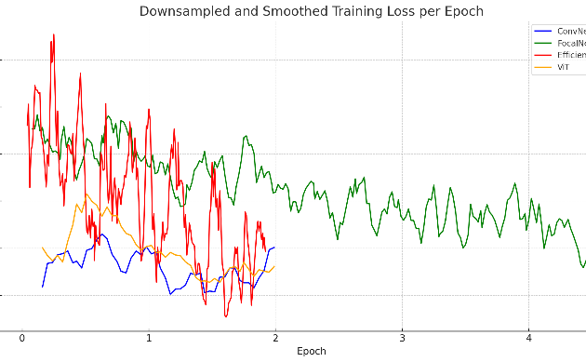
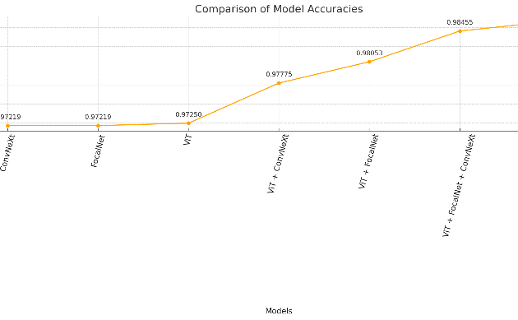
Results
We compare the performance of individual models against our ensemble approach. The ensemble consistently outperforms the individual models, achieving exceptional classification accuracy, as demonstrated by the following graphs and charts.
Performance Comparison
Ensemble Performance
Graph showcasing the superior performance of the ensemble over individual models.
Chart illustrating the accuracy on kaggle achieved by our ensemble approach.

Slide 10

Conclusion
Our ensemble approach to character classification in "The Simpsons" proves highly effective, achieving superior accuracy and robustness. This research holds significant implications for analyzing character dynamics and storytelling patterns. Moving forward, we can explore further improvements and applications of our methodology.

